Slide 1
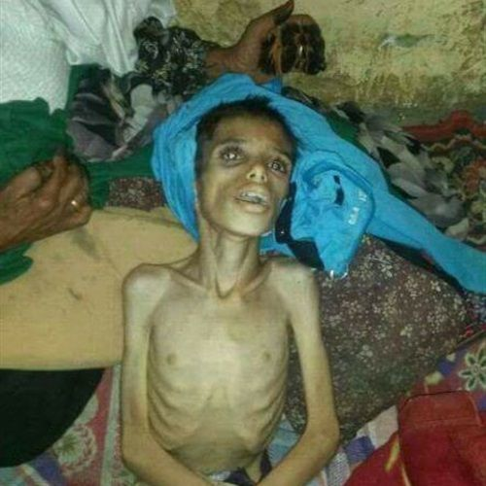
Under-nutrition
Dr. Zainab A. Al-Mayyahi
Department of Medicine
College of Medicine
University of Basrah

Slide 2
Objectives
By the end of this lecture you should be able to:
Identify patients at risk of under-nutrition
Understand causes of under-nutrition
Describe the clinical features of under-nutrition
Assess and classify severity of under-nutrition
Manage different types of under-nutrition

Slide 3
Under nutrition is suspected when there is one of the fallowing conditions
Unintentional weight loss around 10% in preceding 3 months
Body weight is < 90% of ideal for height
BMI < 18.5

Slide 4
Causes of under-nutrition and weight loss in adults
Decreased energy intake
Famine, poverty
Persistent vomiting ( GIT diseases, cancer)
Anorexia
Malabsorption.
Maldigestion.

Slide 5
Increased energy expenditure
Increased BMR (thyrotoxicosis, burn)
Excessive physical activity
Energy loss (e.g. diabetes)
Impaired energy storage ( Addison’s disease)

Slide 6
Clinical features of under-nutrition
Weight loss.
Craving for food.
Amenorrhea or impotence.
Lax, pale, dry skin.
Hair loss.
Muscle-wasting and weakness
Decrease subcutaneous fat and prominent ribs

Slide 7
Clinical features of under-nutrition
Hypothermia, bradycardia, hypotension.
Edema (famine Edema).
Apathy (expressionless face).
Increased susceptibility to infections.
Symptoms and signs of vitamins and minerals deficiencies

Slide 9
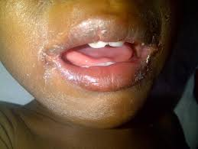

Slide 10
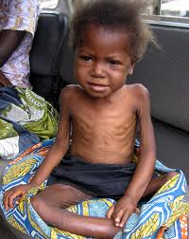
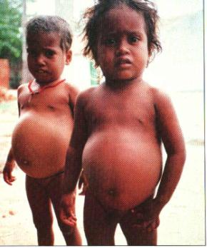
Under nutrition in children
Marasmus
Kwashiorkor

Slide 11
Clinical assessment (BMI)
BMI (kg/m²) | classification
18.5 | Under-nutrition
18.4-17 | Mild
17-16 | Moderate
16> | Severe

Slide 12
Clinical assessment triceps skin fold thickness (mm)

Slide 13
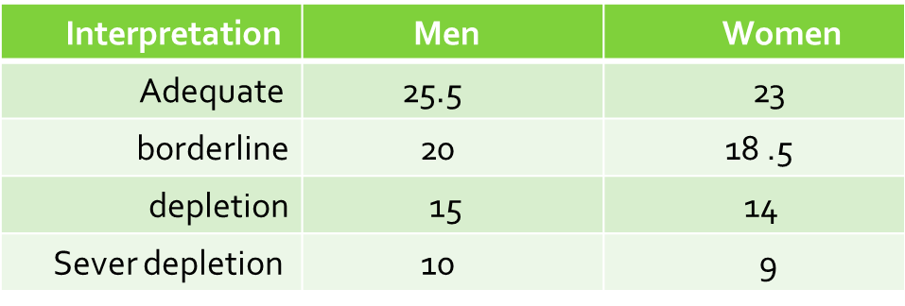
Clinical assessment midarm muscle circumference (cm)

Slide 14
Investigations
Hypoglycemia
Ketosis
Anemia , leucopenia and thrombocytopenia.
ECG shows sinus bradycardia and low voltage
Investigations for the underlying cause

Slide 15
Management of under-nutrition
Treatment of underlying causes if present.
Mild (BMI 17-18.5) not at danger.
Moderate (BMI 16-17) require extra feeding.
Severe (BMI < 16 ) require hospital care.

Slide 16
Treatment of severe under-nutrition
In severe under nutrition, there is suppressed insulin secretion, atrophy of the intestinal epithelium & pancreatic exocrine and bile are dilute
Re-feeding should be slow using special diets supplied with essential micronutrients.
30 kcal/kg is usually requires (1500-2000 kcal/day).
Aim is to increase body weight by 5% per month.

Slide 17
Routes of feeding
1- Normal enteral (oral ) feeding.
2- Enteral tube feeding for patients unable to swallow like CVA patents and throat surgery
*Nasogastric tube feeding.
*percutaneous endoscopic gastrostomy (PEG)
3- Parenteral feeding : Directly through the circulation when other routes are impossible.

Slide 18
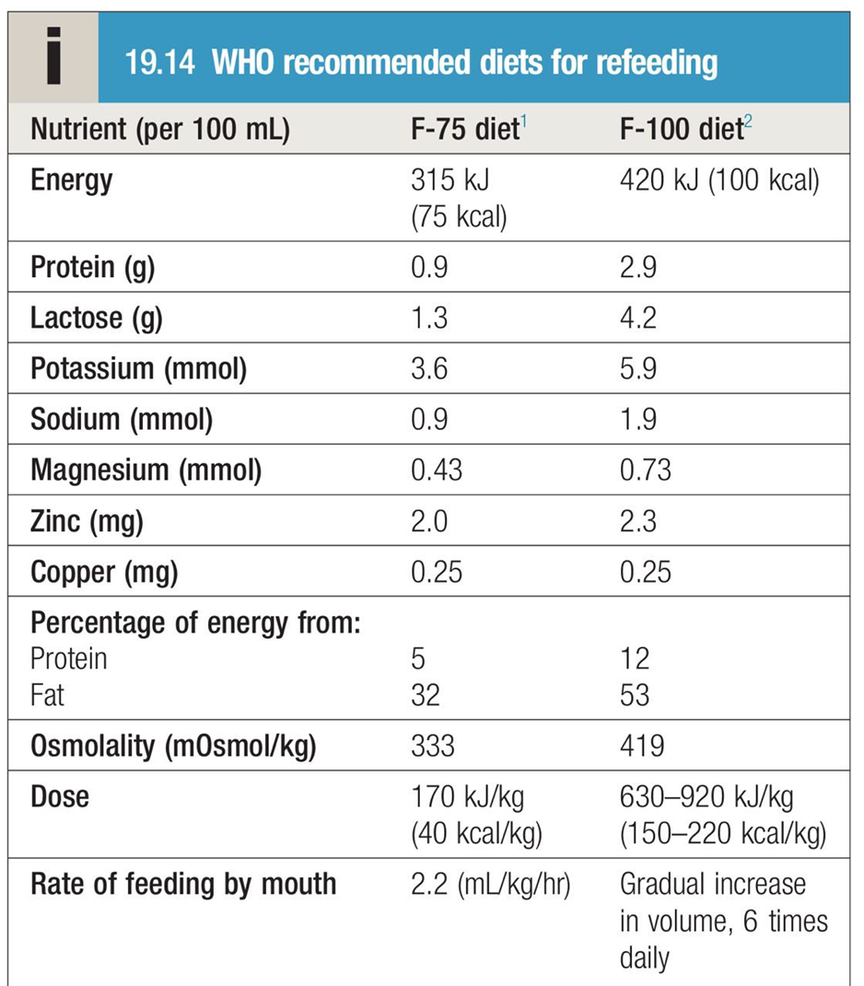

Slide 19
F-75
Milk powder (25 g), sugar ( 70 g), cereal flour (35g) vegetable oil (27 g)& vitamins & minerals made up 1 L of water
F-100
(1 L) contains milk powder (80 g), sugar (50 g), vegetable oil (60 g) and vitamin and mineral supplements (no cereal).

Slide 20
Re-feeding syndrome
Observed in rapid correction of malnutrition due release of insulin which facilitate entry of K, Mg & Phosphate inside the cells leading to electrolytes disturbance s
Nausea , vomiting, muscle weakness seizures, respiratory depression and even cardiac arrest and sudden death can occur

Slide 21
Total parenteral nutrition (TPN)
Expensive and carries high risk of complications
Site of delivery should be a large central vein.
A combination of dextrose , amino acids, lipids and water provides the basic feeding solution to which vitamins and trace menials are added.

Slide 22
Indications of TPN
long term
Temporary
Extensive bowel resection.
Mesenteric infraction.
crohn’s disease.
Scleroderma
Radiation enteritis
Sever diarrhoea
Intractable vomiting.
Patients kept nil by mouth.

Slide 23
Complication of TPN
Thrombophlebitis.
Infection.
Pneumothorax.
Hypo or hyperglycemia.
Electrolytes disturbance “Refeeding syndrome”.
Abnormal renal and liver function tests.
Hyperlipidemia and gallstones.

Slide 24
under-nutrition in hospital
Under-nutrition is a common problem in the hospital setting ( one third of patients):
*Poor appetite.
*Concurrent illness.
*Feeding difficulties.
*”nil by mouth” for long time.

Slide 25
Consequences of under-nutrition in hospital
Impaired immunity.
Muscle weakness.
Delayed wound healing.
Poor response to treatment.
Increase post operative infection.

Slide 26
Nutritional support in hospital
Try to encourage normal balanced diet.
If not adequate, add dietary supplements.
Tube feeding for those unable to swallow.
Parenteral nutrition.

Slide 27
Summary
Under-nutrition is a significant cause of morbidity and mortality (50% of deaths in children)
Famine and poverty is the main cause
Weight loss and decreased BMI is the most common presentation
Severe under-nutrition needs hospital care
Re-feeding should be slow to prevent re-feeding syndrome

